Slide 1

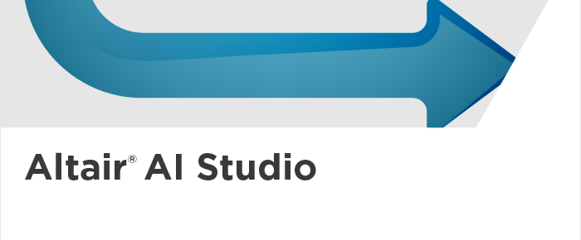
AN ANALYTICAL STUDY USING ALTAIR AI STUDIO
Presented By:
Aishwarya B
B.E Computer Science and Engineering(3rd year)
Sri Sairam Institute of Technology

Slide 2
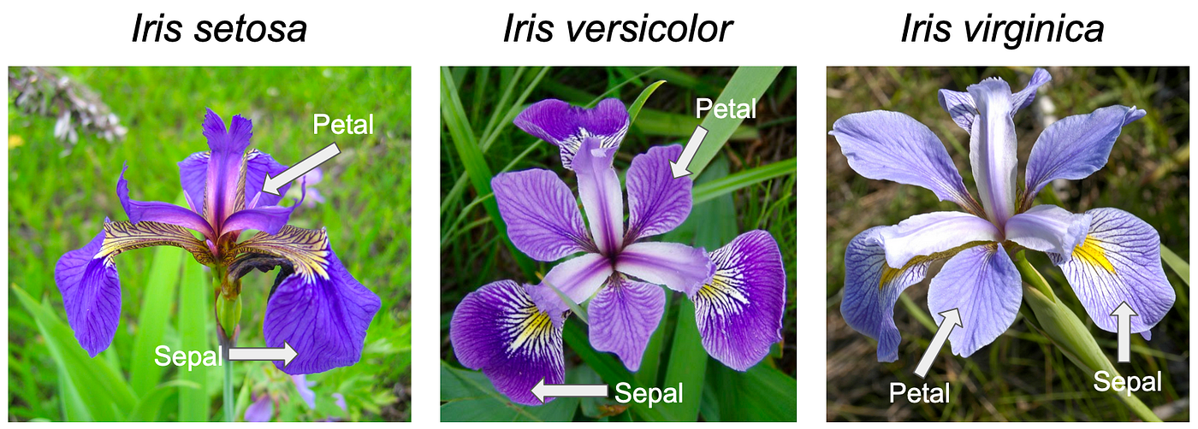
PROBLEM STATEMENT
The objective of this project is to develop a machine learning model that can accurately classify iris flowers into their respective species — Iris setosa, Iris versicolor, and Iris virginica — based on four measurable attributes: sepal length, sepal width, petal length, and petal width.
By analyzing the relationships among these attributes, the goal is to design an efficient classification model using Altair AI Studio that can automatically identify the species of an iris flower from its physical measurements with high accuracy.

Slide 3
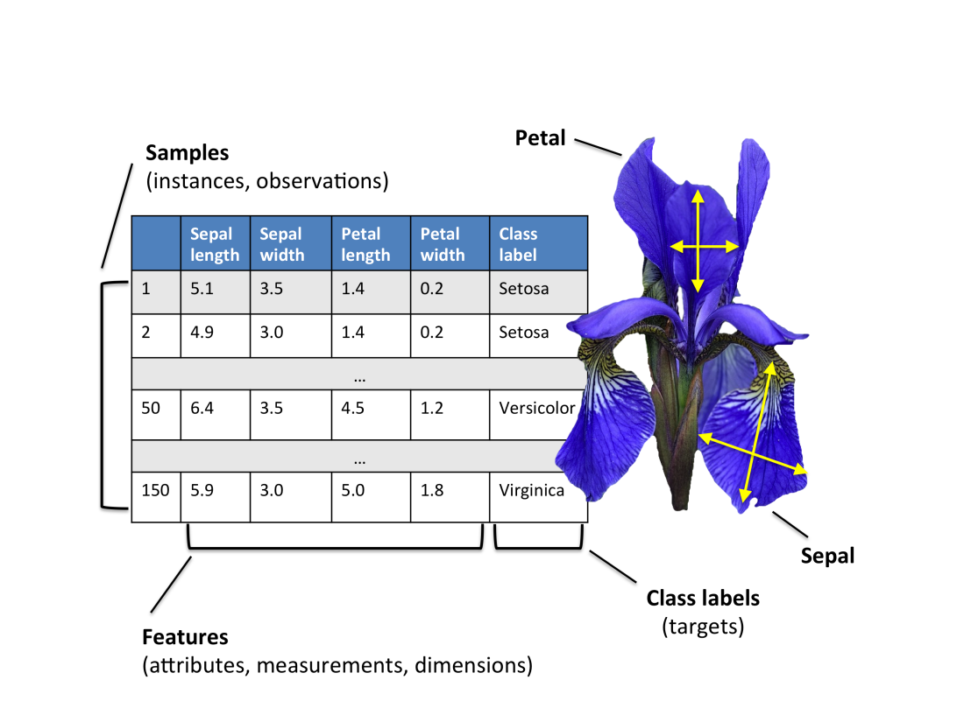
DATASET OVERVIEW
Dataset Name: Iris Dataset (from Kaggle)
Source: Curated by Himanshu Nakrani, originally from the UCI Machine Learning Repository
Records: 150 samples
Features:
Sepal Length
Sepal Width
Petal Length
Petal Width
Species (Target)
Species: Iris setosa, Iris versicolor, Iris virginica
Type: Clean, well-balanced dataset with no missing values
Goal: Classify the flower species based on petal and sepal measurements

Slide 4
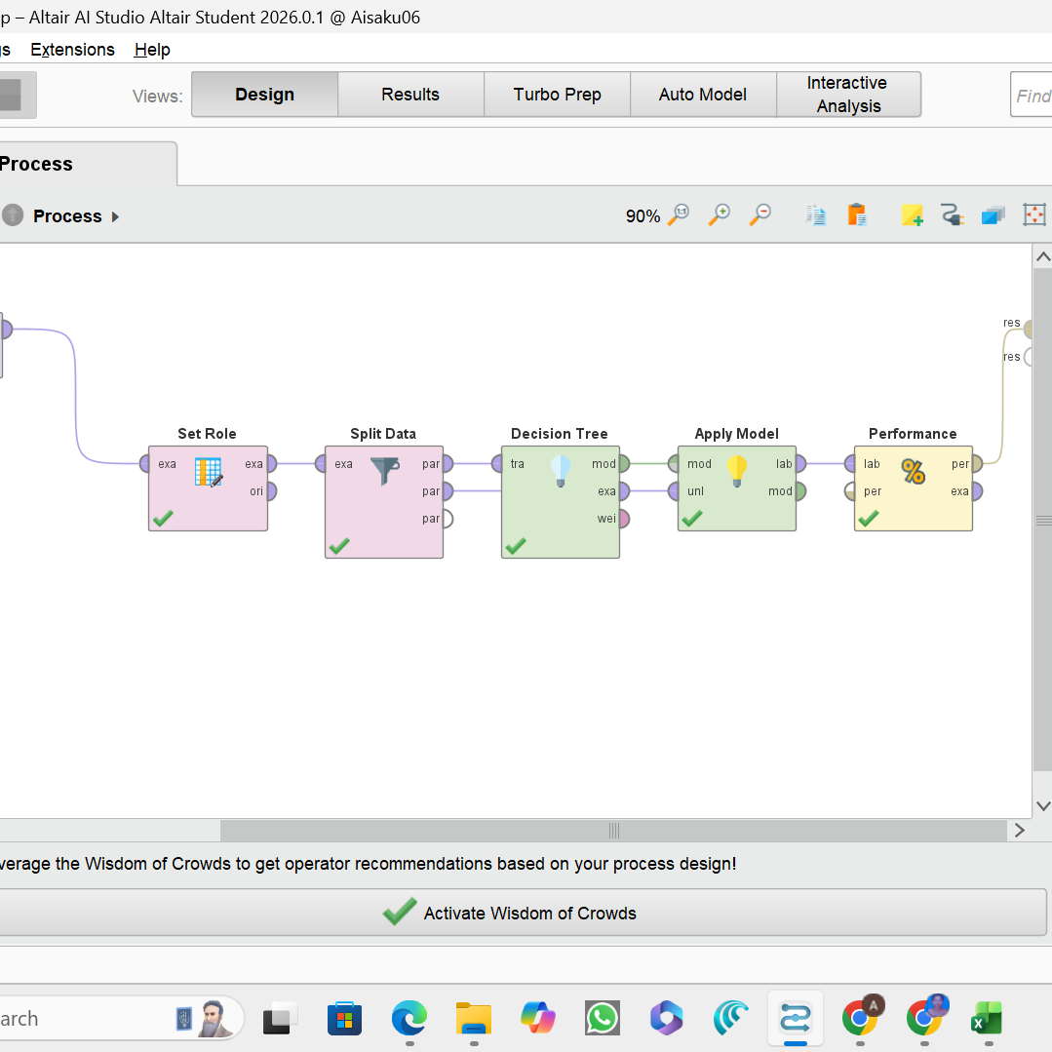
METHODOLOGY AND PROCESS FLOW
Data Collection:
  Used the Iris dataset from Kaggle containing 150 records and 5 attributes.
Data Preprocessing:
  Verified no missing values.
  Set the ‘Species’ column as the label (target) using Set Role.
Data Splitting:
  Split the dataset into training (70%) and testing (30%) subsets.
Model Building:
  Applied the Decision Tree algorithm to train the model.
Model Testing & Evaluation:
  Used the Apply Model and Performance operators to test accuracy.
  Achieved an overall accuracy of 91% in predicting flower species.

Slide 5
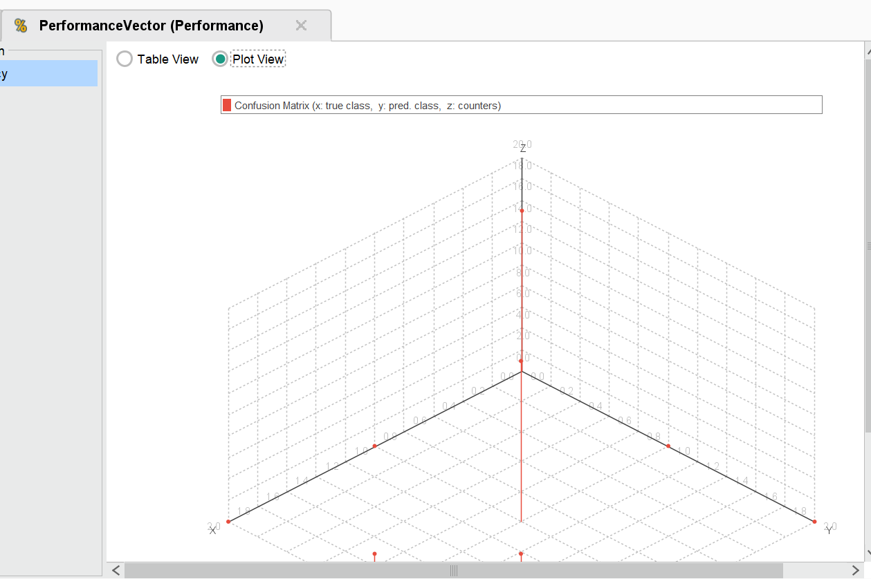

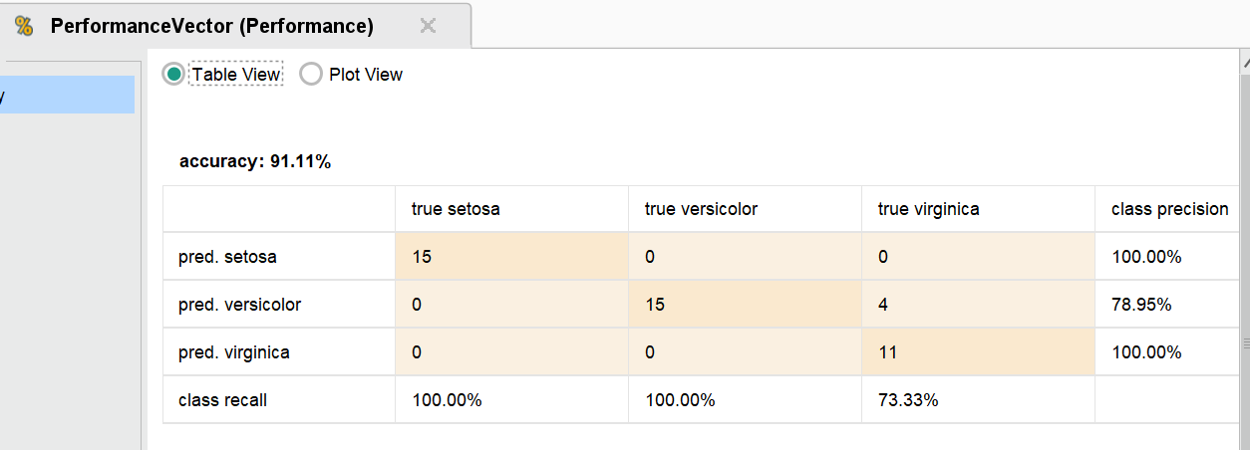
MODEL BUILDING AND ACCURACY

Slide 6


